Slide 1
Views in SQL
CS345

Slide 2
What is a View?
A View is a virtual table based on the result-set of an SQL statement.
It can also be considered as a saved SQL query.

Slide 3
Views in SQL
Pid | Pname | Salary | Gender | DeptId
1 | A | 50000 | Female | 3
2 | B | 54000 | Female | 2
3 | C | 60000 | Male | 1
4 | D | 73000 | Female | 4
5 | E | 81000 | Male | 1
6 | F | 40000 | Male | 3
Pid | Pname | Salary | Gender | DeptName
1 | A | 50 000 | Female | HR
2 | B | 54000 | Female | Payroll
3 | C | 60000 | Male | IT
4 | D | 73000 | Female | Admin
5 | E | 81000 | Male | IT
6 | F | 40000 | Male | HR
DeptId | DeptName
1 | IT
2 | Payroll
3 | HR
4 | Admin
Base Tables
View
create view v1
as
select Pid, Name, Salary, Gender, DeptName
from Employees natural join Department;
select Pid, Name, Salary, Gender, DeptName
from Employees natural join Department;

Slide 4
Alter or Drop a View
Alter: ALTER VIEW <statement>;
Drop: DROP VIEW <view_name>;

Slide 5
Advantages of Views
Views can be used to reduce the complexity of the database schema

Slide 6
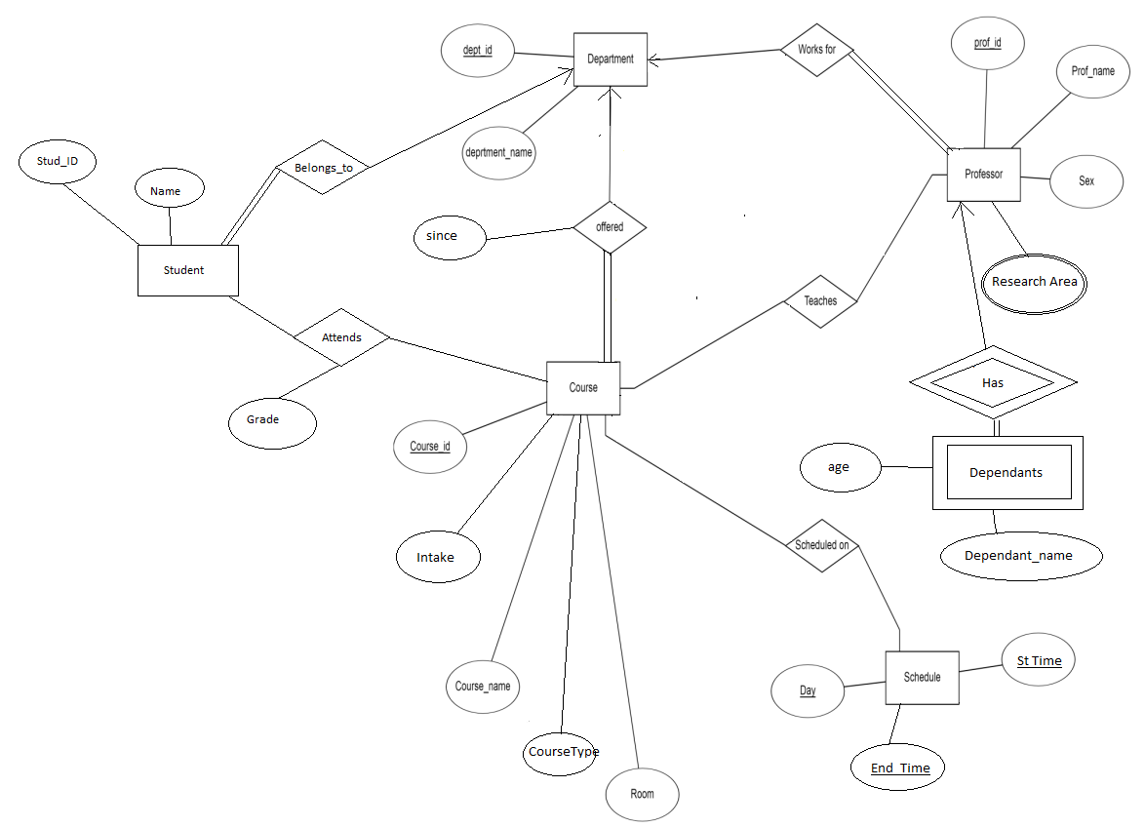
Views can model complex joins easily

Slide 7
Advantages of Views
Views can be used to reduce the complexity of the database schema
Views can be used as a mechanism to implement row and column level security

Slide 8
Row-level security
Pid | Pname | Salary | Gender | DeptId
1 | A | 50 000 | Female | 3
2 | B | 54000 | Female | 2
3 | C | 60000 | Male | 1
4 | D | 73000 | Female | 4
5 | E | 81000 | Male | 1
6 | F | 40000 | Male | 3
DeptId | DeptName
1 | IT
2 | Payroll
3 | HR
4 | Admin
Pid | Pname | Salary | Gender | DeptName
3 | C | 60000 | Male | IT
5 | E | 81000 | Male | IT
create view v2
as
select Pid, Name, Salary, Gender, DeptName
from Employees natural join Department
where DeptName=‘IT’;

Slide 9
Column-level security
Pid | Pname | Salary | Gender | DeptId
1 | A | 50000 | Female | 3
2 | B | 54000 | Female | 2
3 | C | 60000 | Male | 1
4 | D | 73000 | Female | 4
5 | E | 81000 | Male | 1
6 | F | 40000 | Male | 3
Pid | Pname | Gender | DeptName
1 | A | Female | HR
2 | B | Female | Payroll
3 | C | Male | IT
4 | D | Female | Admin
5 | E | Male | IT
6 | F | Male | HR
DeptId | DeptName
1 | IT
2 | Payroll
3 | HR
4 | Admin
create view v3
as
select Pid, Name, Gender, DeptName
from Employees natural join Department;

Slide 10
Advantages of Views
Views can be used to reduce the complexity of the database schema
Views can be used as a mechanism to implement row and column level security
Views can be used to present aggregated data and hide detailed data, in this way it provides abstraction over tables

Slide 11
Views with Aggregate Functions
Pid | Pname | Salary | Gender | DeptId
1 | A | 50000 | Female | 3
2 | B | 54000 | Female | 2
3 | C | 60000 | Male | 1
4 | D | 73000 | Female | 4
5 | E | 81000 | Male | 1
6 | F | 40000 | Male | 3
DeptId | DeptName
1 | IT
2 | Payroll
3 | HR
4 | Admin
DeptName | TotalEmp
Admin | 1
HR | 2
IT | 2
Payroll | 1
create view v4
as
select DeptName, COUNT(Pid) as TotalEmp
from Employees natural join Department
group by DeptName;

Slide 12
Advantages of Views
Views can be used to reduce the complexity of the database schema
Views can be used as a mechanism to implement row and column level security
Views can be used to present aggregated data and hide detailed data, in this way it provides abstraction over tables.

Slide 13
Updateable Views
Update values in Views
Delete rows from Views
Insert rows into Views

Slide 14
Update Views
Pid | Pname | Gender | DeptId
1 | A | Female | 3
2 | B | Female | 2
3 | C | Male | 1
4 | D | Female | 4
5 | E | Male | 1
6 | F | Male | 3
Pid | Pname | Gender | DeptId
1 | A | Female | 3
2 | G | Female | 2
3 | C | Male | 1
4 | D | Female | 4
5 | E | Male | 1
6 | F | Male | 3
create view view_except_salary
as
select Pid, Name, Gender, DeptId
from Employees;
update view_except_salary
set Pname=‘G’ where Pid=2;

Slide 15
Delete from Views
Pid | Pname | Gender | DeptId
1 | A | Female | 3
2 | B | Female | 2
3 | C | Male | 1
4 | D | Female | 4
5 | E | Male | 1
6 | F | Male | 3
Pid | Pname | Gender | DeptId
1 | A | Female | 3
3 | C | Male | 1
4 | D | Female | 4
5 | E | Male | 1
6 | F | Male | 3
create view view_except_salary
as
select Pid, Name, Gender, DeptId
from Employees;
Delete from view_except_salary
where Pid=2;

Slide 16
Insert into Views
Pid | Pname | Gender | DeptId
1 | A | Female | 3
2 | B | Female | 2
3 | C | Male | 1
4 | D | Female | 4
5 | E | Male | 1
6 | F | Male | 3
Pid | Pname | Gender | DeptId
1 | A | Female | 3
2 | B | Female | 2
3 | C | Male | 1
4 | D | Female | 4
5 | E | Male | 1
6 | F | Male | 3
7 | G | Female | 4
create view view_except_salary
as
select Pid, Name, Gender, DeptId
from Employees;
Insert into view_except_salary
values (7, ’G’, ‘Female’, 4);

Slide 17
Restrictions on Updateable Views
A view is not a table and contains no data hence, the actual modification always takes place at the table level.
Views cannot be used as a mechanism to override any constraints, rules, or referential integrity defined in the base tables.

Slide 18
Update Views
Pid | Pname | Gender | DeptName
1 | A | Female | HR
2 | B | Female | Payroll
3 | C | Male | IT
4 | D | Female | Admin
5 | E | Male | IT
6 | F | Male | HR
Pid | Pname | Gender | DeptName
1 | A | Female | IT
2 | B | Female | Payroll
3 | C | Male | IT
4 | D | Female | Admin
5 | E | Male | IT
6 | F | Male | IT
create view v3
as
select Pid, Name, Gender, DeptName
from Employees natural join Department;
update v3
set DeptName=‘IT’ where Pname=‘A’;

Slide 19
Update Views
Pid | Pname | Salary | Gender | DeptId
1 | A | 50000 | Female | 3
2 | B | 54000 | Female | 2
3 | C | 60000 | Male | 1
4 | D | 73000 | Female | 4
5 | E | 81000 | Male | 1
6 | F | 40000 | Male | 3
Pid | Pname | Salary | Gender | DeptId
1 | A | 50000 | Female | 3
2 | B | 54000 | Female | 2
3 | C | 60000 | Male | 1
4 | D | 73000 | Female | 4
5 | E | 81000 | Male | 1
6 | F | 40000 | Male | 3
DeptId | DeptName
1 | IT
2 | Payroll
3 | HR
4 | Admin
DeptId | DeptName
1 | IT
2 | Payroll
3 | IT
4 | Admin
update v3
set DeptName=‘IT’ where Pname=‘A’;

Slide 20
Restrictions on Updateable Views
Aggregate functions like SUM(), COUNT(), MAX() and MIN() cannot be used while updating a view.
DISTINCT, GROUP BY, HAVING, UNION, UNION ALL or a sub-query in the select list also cannot be used while updating a view.

Slide 21
With Check Option
Forces all data modification statements executed against the view to follow a certain criteria set.
When a row is modified through a view, the WITH CHECK OPTION makes sure the data remains visible through the view after the modification is committed.

Slide 22
With Check Option
CREATE VIEW vwCustomersParis
AS
SELECT CompanyName, ContactName, Phone, City
FROM Customers
WHERE City = 'Paris’
WITH CHECK OPTION;
UPDATE vwCustomersParis SET City = ‘Delhi’

